Slide 1
C# Operators
By Nimesh Kumar Dagur

Slide 2
C# Operators
An operator is a symbol that tells the compiler to perform specific mathematical or logical manipulations.
Operators are used for building expressions in C#.
To calculate the value of variable or performs operation in variable you will have to make proper expression.
These expressions are made using C# operators.

Slide 3
C# Operators
C# provides wide range of operators:
Arithmetic Operators
Assignment Operators
Unary operators
Relational (Comparison) Operators
Logical Operators
Ternary operator

Slide 4
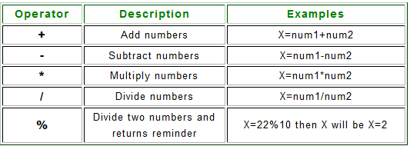
Arithmetic Operators
Arithmetic Operators are used for basic mathematical calculation in C# programming.

Slide 5
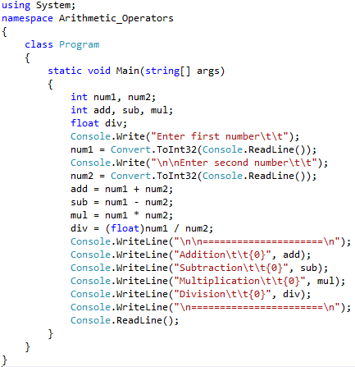
Example:

Slide 6
C# Assignment Operators
The C# assignment operator is generally suffix with arithmetic operators.
The symbol of c sharp assignment operator is "=" without quotes.
The assignment operator widely used with C# programming.

Slide 7
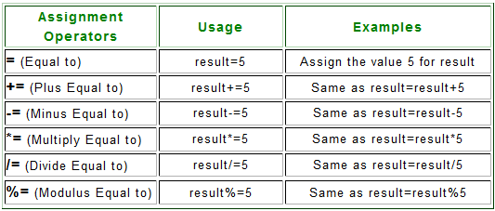
C# Assignment Operators

Slide 8
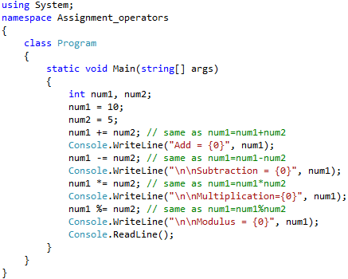
Example:

Slide 9
C# Unary Operators
The C# unary operator is widely used for increment or decrement value by 1.
This operator widely used with loop constructs to increment loop by 1.
++ Increment Operator:
This operator is pronounced as increment operator.
It is used for incrementing value by 1.
It is used in C# programming by two types:
Pre-increment (++i) and Post-increment (i++).
In pre-increment, first it increments by 1 then loop executes whereas in Post-increment, the loop executes then it increments by 1.

Slide 10
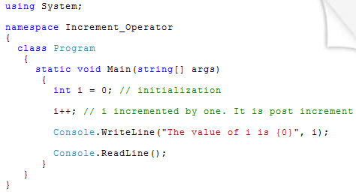
C# Unary Operators

Slide 11
C# Unary Operators
-- Decrement Operator:
The behavior of decrement operator is just opposite from increment operator.
It is used for decrementing the value by one.
It has also two types:
Pre-Decrement (--i) and Post Decrement (i--).
In pre-decrement the value is decremented by one then loop executes whereas in post-decrement the loop executed then the value decrements by one

Slide 12
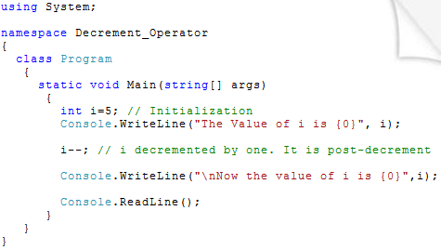
C# Unary Operators

Slide 13
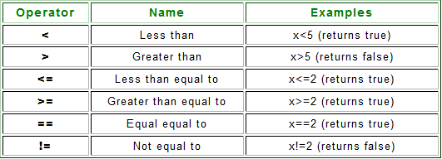
C# Comparison Operators
The C# comparison operator is used to compare two operands.
It returns true or false based on comparison.

Slide 14
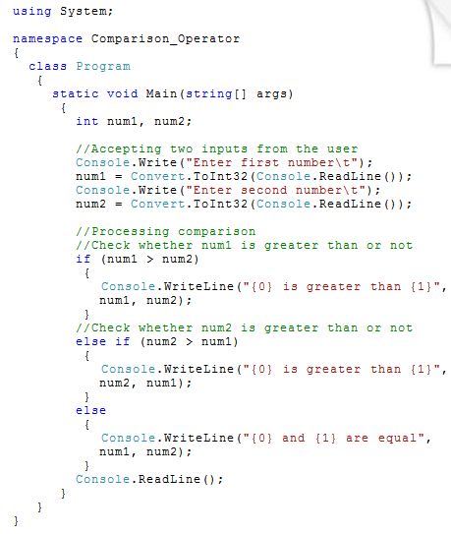
Example:

Slide 15
C# Logical Operator
The C# Logical Operators also evaluate the values and returns true or false as output.
Based on true-false the program behave dynamically at run time.
These operators are widely used with C# programming.
&& Operator (and Operator)
|| Operator (or Operator)
! Operator (not Operator
^ Operator (xor operator)

Slide 16
&& Operator
It is pronounced as and operator.
It returns true if both or all the condition is true and return false if any of the condition is false.

Slide 17
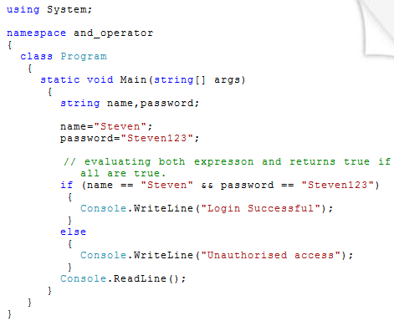

Slide 18
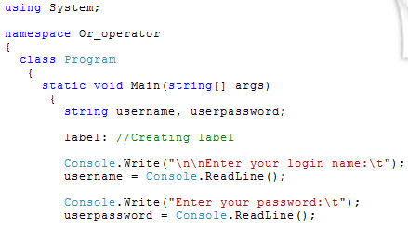
|| Operator
It is pronounced as or operator.
It also returns true or false based on condition.
If any one of the condition matches then it returns true but if both or all the conditions are false then it returns false.

Slide 19
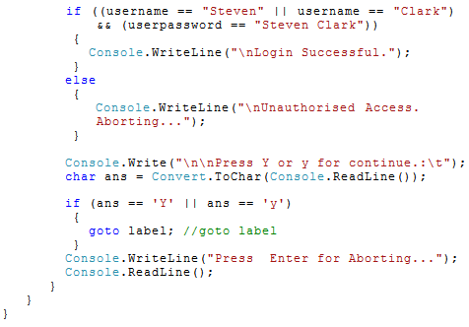

Slide 20
! Operator:
It is pronounced as not operator.
It returns true if expression is false.
The following demonstration will clear the concept of not operator.

Slide 21
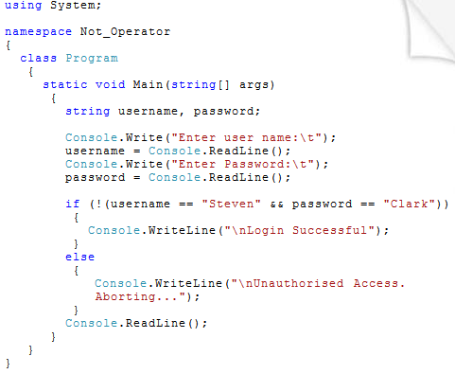

Slide 22
^ Operator
It is pronounced as xor operator.
It returns false if the following condition matches:
(i) if both or all the expression returns true.
(ii) If both or all the expression returns false.

Slide 23
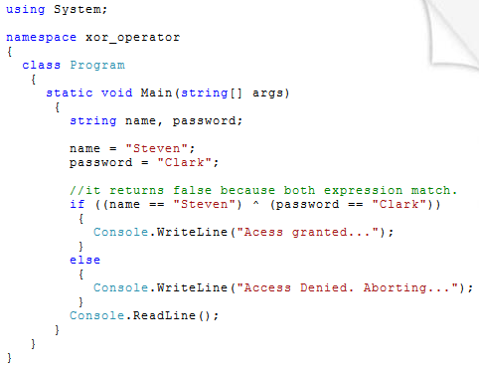

Slide 24
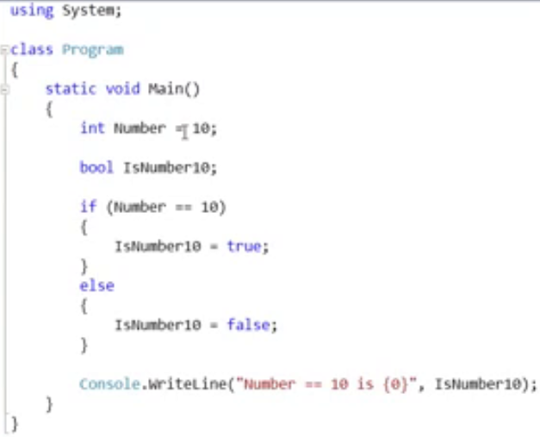
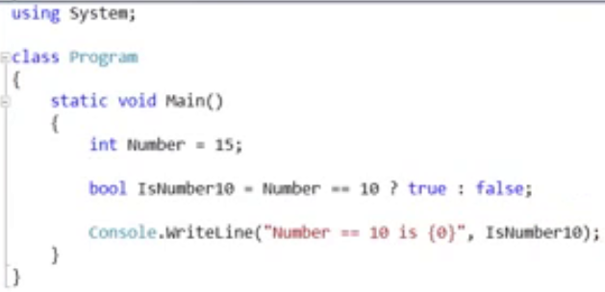
Ternary Operator

Slide 25
C# - Operators Precedence and Associativity
Operators Precedence:
Operator precedence determines the grouping of terms in an expression.
This affects evaluation of an expression.
Certain operators have higher precedence than others;
Example:
The multiplication operator has higher precedence than the addition operator.
x = 7 + 3 * 2;
here, x is assigned 13, not 20 because operator * has higher precedence than + .

Slide 26
C# - Operators Precedence and Associativity
Operator Associativity:
When an operand occurs between two operators with the same precedence, the associativity of the operators controls the order in which the operations are performed:
Except for the assignment operators, all binary operators are left-associative, meaning that operations are performed from left to right.
Example: x + y + z is evaluated as (x + y) + z.
The assignment operators and the conditional operator (?:) are right-associative, meaning that operations are performed from right to left.
Example: x = y = z is evaluated as x = (y = z).
Precedence and associativity can be controlled using parentheses

Slide 27
C# - Operators Precedence and Associativity
Category | Operator | Associativity
Postfix | () [] -> . ++ - - | Left to right
Unary | + - ! ~ ++ - - | Right to left
Multiplicative | * / % | Left to right
Additive | + - | Left to right
Shift | << >> | Left to right
Relational | < <= > >= | Left to right
Equality | == != | Left to right
Bitwise AND | & | Left to right
Bitwise XOR | ^ | Left to right
Bitwise OR | | | Left to right
Logical AND | && | Left to right
Logical OR | || | Left to right
Conditional | ?: | Right to left
Assignment | = += -= *= /= %=>>= <<= &= ^= |= | Right to left
Comma | , | Left to right
Highest
precedence
Lowest
precedence

Slide 28
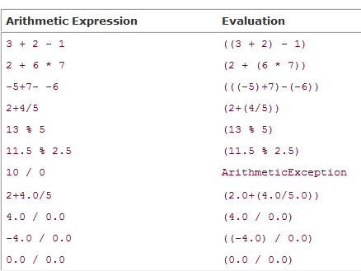

Slide 29
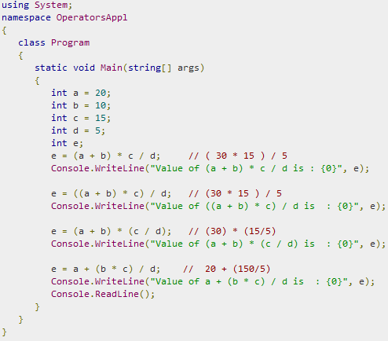
C# - Operators Precedence and Associativity : Example

